Slide 1

Version Control System using Git & GitHub
Master essential commands, collaboration workflows, and real-world project implementation

Slide 2

Understanding Version Control Systems
Version control systems are fundamental tools in modern software development that track and manage changes to source code over time. They maintain a complete history of every modification, enabling developers to understand what changed, when it changed, and who made the change.
These systems allow multiple developers to work on the same codebase simultaneously without overwriting each other's work. If something goes wrong, you can easily roll back to any previous version, making development safer and more efficient.
Track Changes
Team Collaboration
Safe Rollback
Monitor every modification to your codebase with detailed history
Enable multiple developers to work together seamlessly
Revert to any previous version when issues arise

Slide 3

Problems Without Version Control
Code Overwriting
Team members accidentally overwrite each other's work, leading to loss of important changes and wasted development time.
No Change History
Without tracking, it becomes impossible to understand what changed, when it changed, or why it was modified.
Collaboration Chaos
Manual file sharing through email or shared drives creates confusion, version conflicts, and integration nightmares.
Manual Backup Burden
Developers resort to creating multiple file copies with names like "final", "final2", "final_final", creating organisational chaos.

Slide 4

Evolution of Version Control Systems
Local VCS
Distributed VCS
Simple database on local machine keeping file versions. Limited to single developer, no collaboration support.
Every developer has complete repository (Git, Mercurial). Work offline, faster operations, high reliability.
1
2
3
Centralized VCS
Single server stores all versions (SVN, CVS). Multiple users can collaborate but server dependency creates bottleneck.
Why Distributed VCS (Git) Wins
Work offline without network connectivity
Lightning-fast operations compared to centralized systems
Every developer has full repository backup
High fault tolerance and reliability

Slide 5
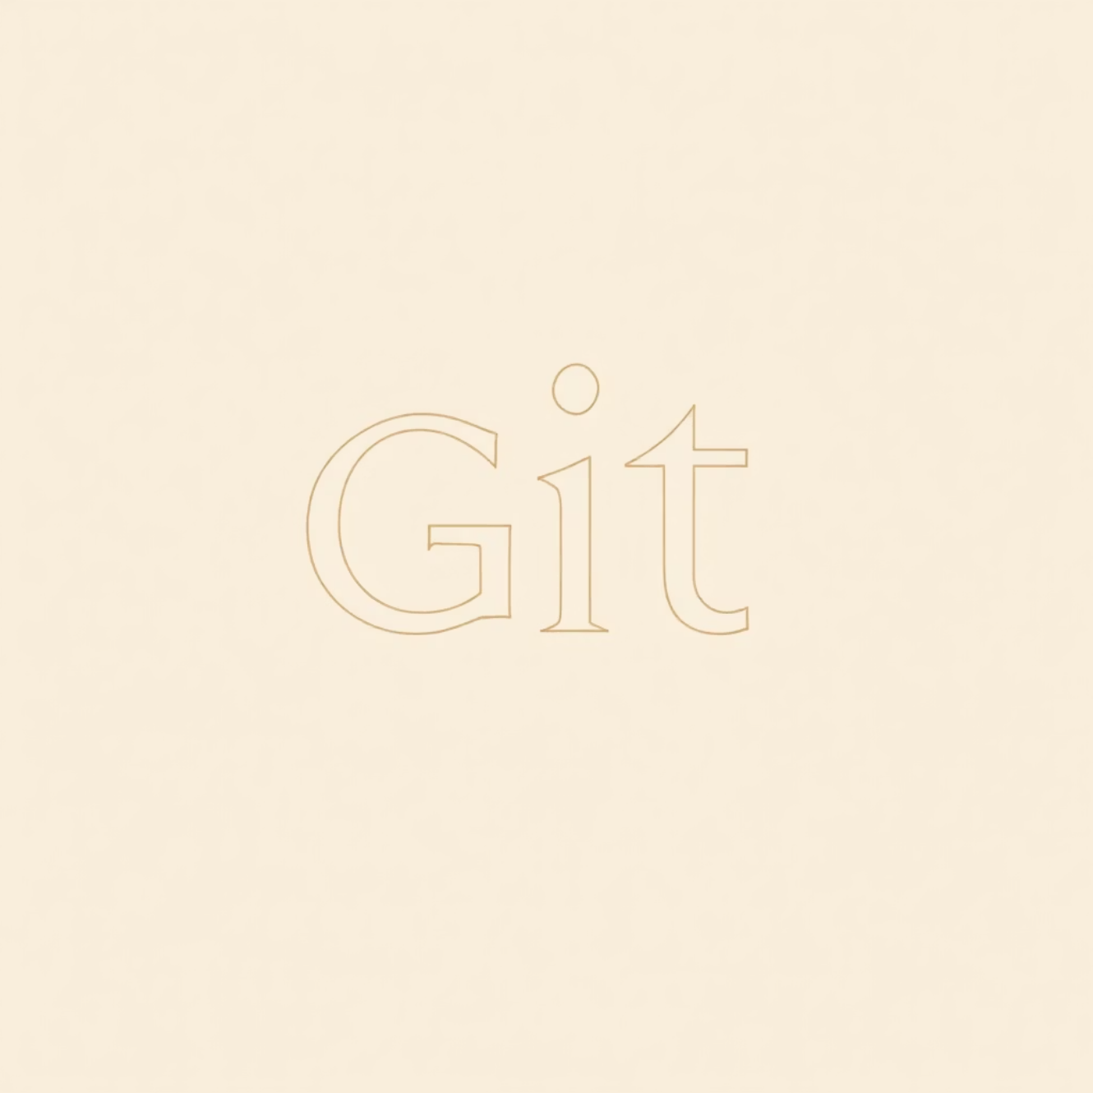
Introduction to Git
Git is a distributed version control system created by Linus Torvalds in 2005 to manage Linux kernel development. Today, it has become the industry standard tool used by millions of developers worldwide.
As an open-source tool, Git is completely free and offers exceptional performance. Its distributed architecture means every developer has the entire project history locally, enabling fast operations and offline work capabilities.
2005
100M+
1
Created
Users
Industry Standard
By Linus Torvalds
Developers worldwide
Most popular VCS

Slide 6
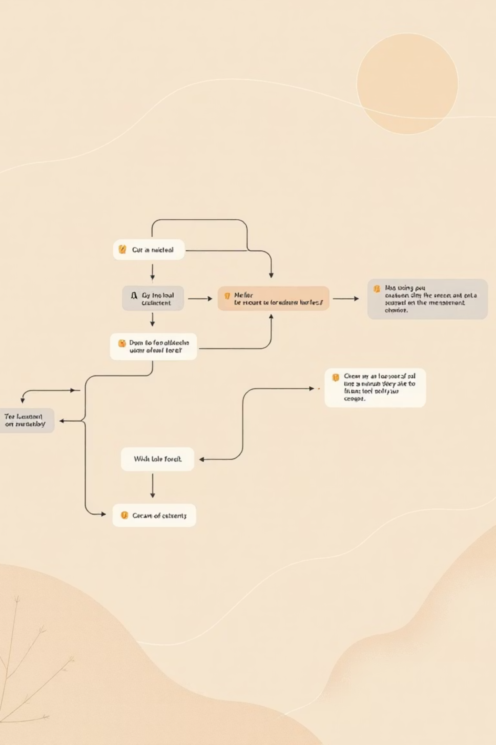



Git Architecture & File States
Working Directory
Your workspace where you actively edit and modify files
Staging Area
Prepares selected changes before committing to repository
Local Repository
Stores committed snapshots with complete history
Understanding Git File States
01
Untracked: New files that Git hasn't started monitoring yet
02
Modified: Tracked files that have been changed but not staged
03
Staged: Modified files marked for inclusion in next commit
04
Committed: Changes safely stored in local repository

Slide 7
Essential Git Commands
1
2
3
git init
git status
git add
Initializes a new Git repository in your project directory. Creates hidden .git folder containing all version control data.
Shows current state of working directory and staging area. Displays which files are modified, staged, or untracked.
Stages files for commit. Use git add filename for specific files or git add . for all changed files.
git init
git status
git add .
4
5
git commit
git log
Saves staged snapshot to repository with descriptive message. Each commit gets unique identifier.
Displays detailed commit history. Use --oneline flag for compact view showing commit IDs and messages.
git commit -m "Add login feature"
git log --oneline

Slide 8


Git vs GitHub: Understanding the Difference
Git
GitHub
Version control software tool
Cloud hosting platform for Git repositories
Runs locally on your machine
Enables online collaboration
Manages commits, branches, and history
Provides Pull Requests and Issues
Works completely offline
Requires internet connection
Command-line based
Web-based interface with additional features
Key Concept: Git is the engine, GitHub is the garage. You need Git to use GitHub, but you can use Git without GitHub.
Connecting Git to GitHub
git remote add origin https://github.com/username/repo.git
git branch -M main
git push -u origin main

Slide 9

Branching & Collaboration Workflows
Understanding Branches
Handling Merge Conflicts
Branches allow isolated development without affecting the main codebase. The main branch contains stable, production-ready code while feature branches enable developers to work on new functionality independently.
Conflicts occur when the same file is edited in different branches. Git marks conflicting sections, requiring manual resolution.
Essential Branch Commands
Git identifies conflict areas
Developer reviews both versions
git branch # List branches
git checkout -b feature-login # Create new branch
git merge feature-login # Merge branch
Choose or combine changes
Commit resolved version
Standard Team Workflow
Clone repository from GitHub
Create feature branch
Commit changes locally
Push branch to GitHub
Create Pull Request for review
Review, approve, and merge

Slide 10



Real Project Case Study: Online Shopping Application
Login Module
Product Module
Cart Module
Orders Module
Developer 1 on feature-login branch
Developer 2 on feature-product branch
Developer 3 on feature-cart branch
Developer 4 on feature-orders branch
Project Implementation
Key Benefits Achieved
Team of 4 developers building an online shopping application using single GitHub repository. Each developer works on dedicated feature branch for their module, ensuring parallel development without conflicts.
Parallel development across all modules
Zero code loss with complete history
Daily workflow involves committing changes frequently, pushing branches to GitHub, and raising Pull Requests for code review by team lead before merging into main branch.
High code quality through PR reviews
Easy rollback if issues detected
Clear accountability for changes
Seamless collaboration and integration
Best Practices & Interview Tips
Git Best Practices
Common Interview Questions
Industry Applications
Commit small changes frequently
Difference between Git and GitHub?
Essential in Agile & DevOps teams
Write clear, descriptive messages
What is a branch and why use it?
Mandatory for CI/CD pipelines
Always use feature branches
Explain Pull Request workflow
Integrated with Jira, Jenkins
Pull before pushing changes
How to resolve merge conflicts?
Used in all modern companies
Review code via Pull Requests
Git commands for daily workflow?
Core skill for developers
Summary
Git manages code versions with powerful branching and merging capabilities. GitHub enables seamless collaboration through Pull Requests and Issues. Together, they form the foundation of modern software development, making version control and teamwork efficient, transparent, and reliable. Mastering Git and GitHub is an essential skill for every developer in today's industry.

